Slide 1

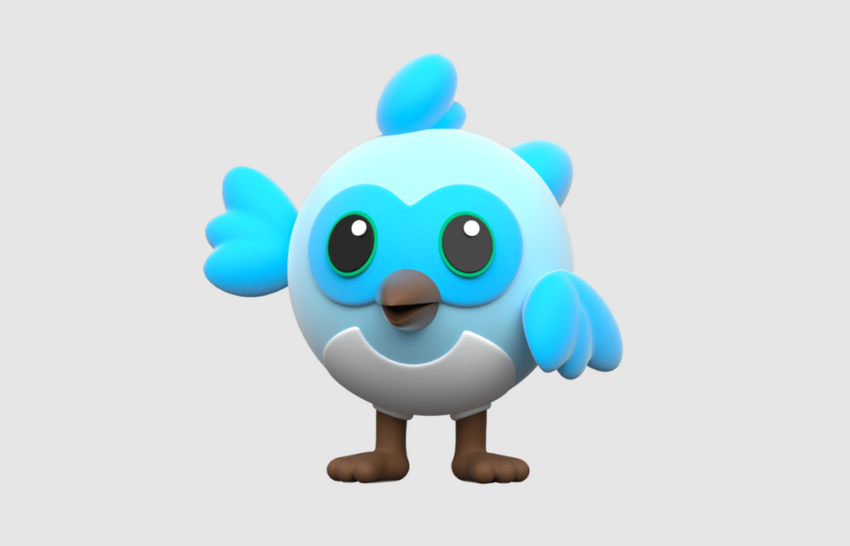
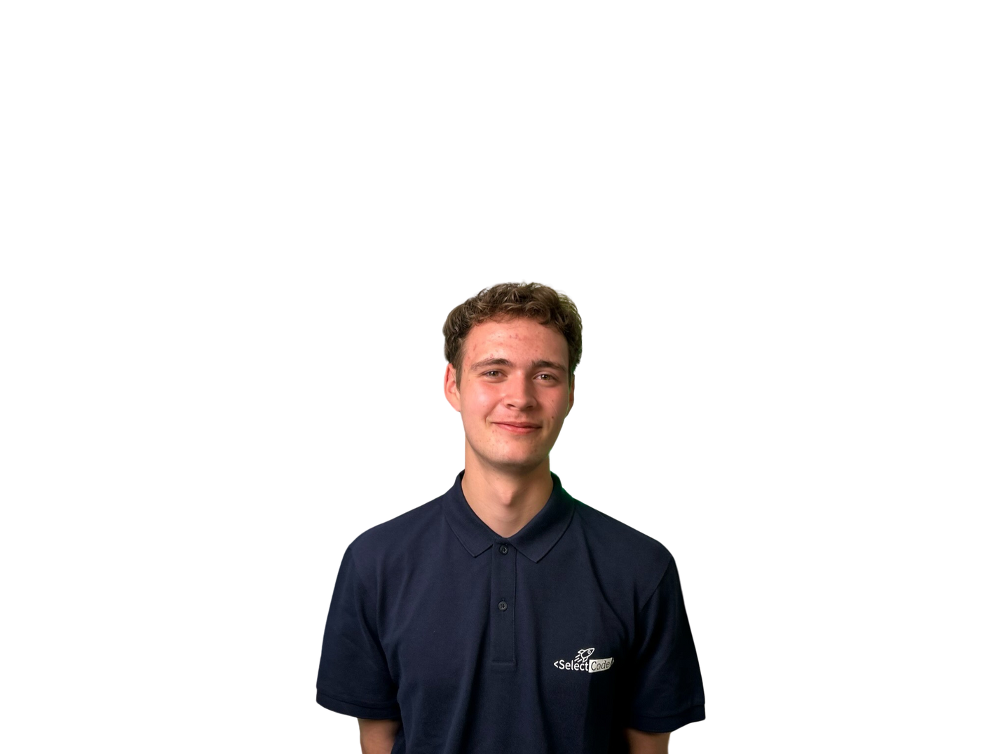

Julian Hartl
12.01.2024

Slide 2

That’s me
Julian Hartl
Computer Science student at TUM
Software Engineer at SelectCode for ~ 2 years
Currently: Full stack development
Before: Mainly Flutter

Slide 3








We develop the future
We are an IT agency for startups and medium-sized businesses
We are an IT service provider to develop innovative and sustainable SaaS platforms, apps and AI-based tools to advance the technology of the future. With our development team in Munich and our strong ties to TUM, we are at the cutting edge of technology.
what we use besides Flutter:
2017
18
10+
Foundation
Team members
Projects

Slide 4
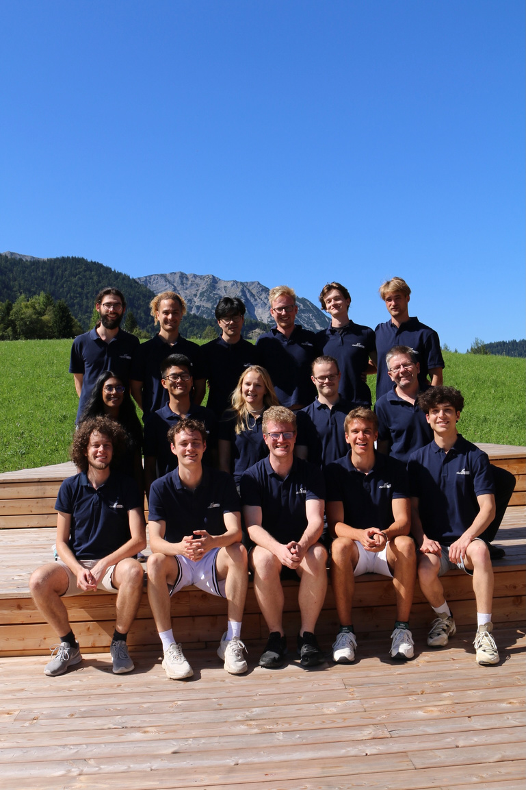
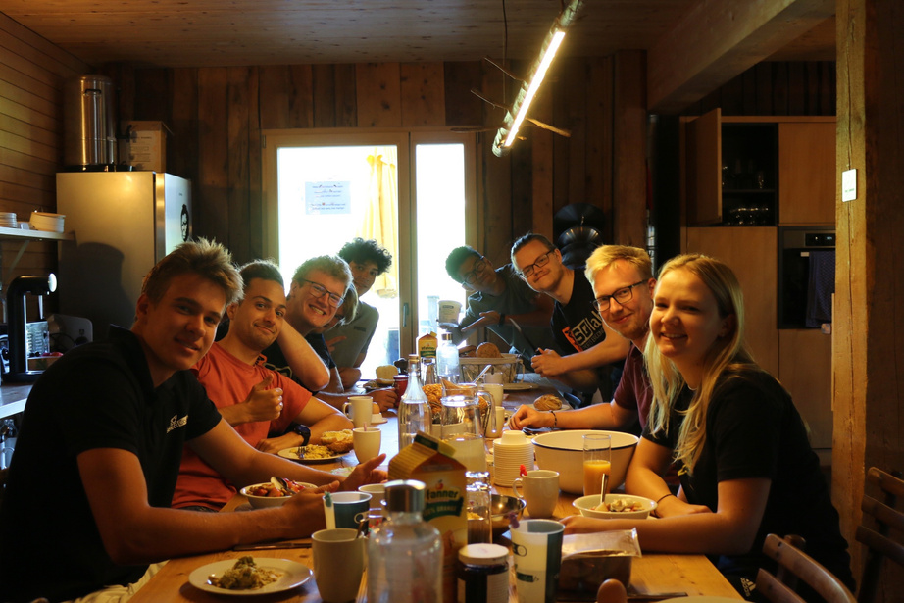
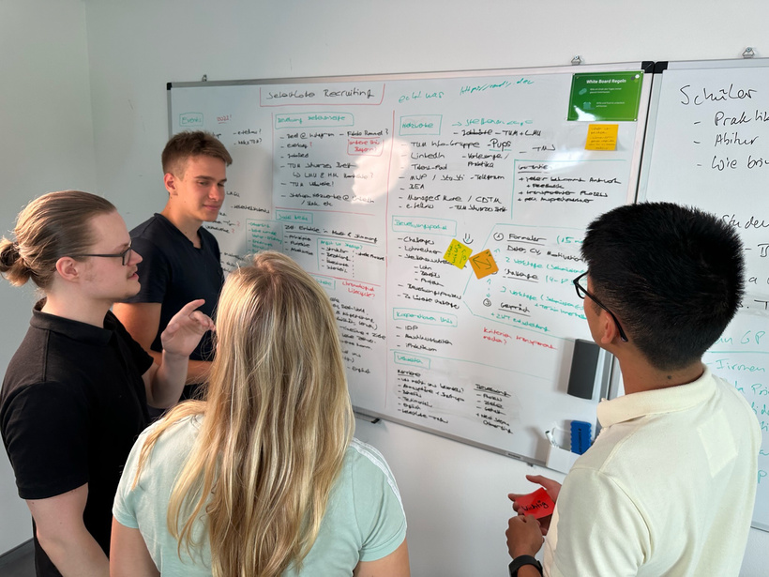


Our Top 3 why...
...you should join the SelectCode
Working student team
Events & Workshops
Good salary
currently 16 working students
eg. SelectCode Weekend
18 - 27 €
Still free on 19.01.?
Then take part in our Coding Escape Room competition!

Slide 5
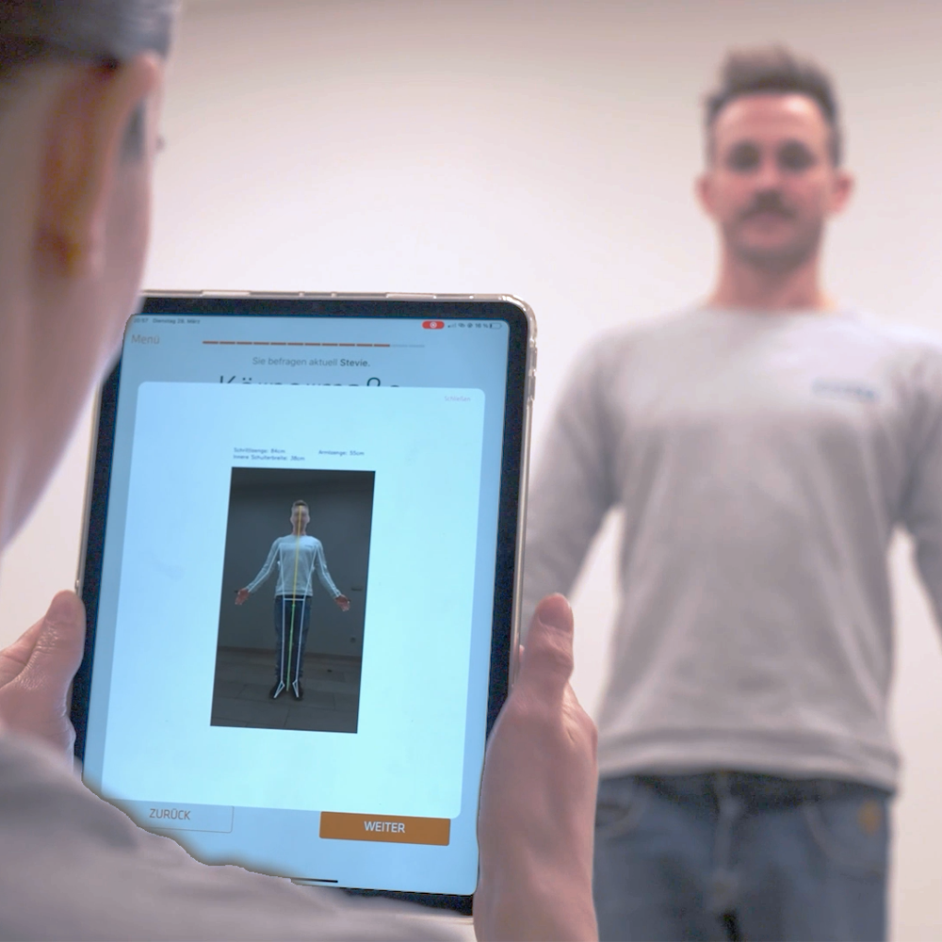

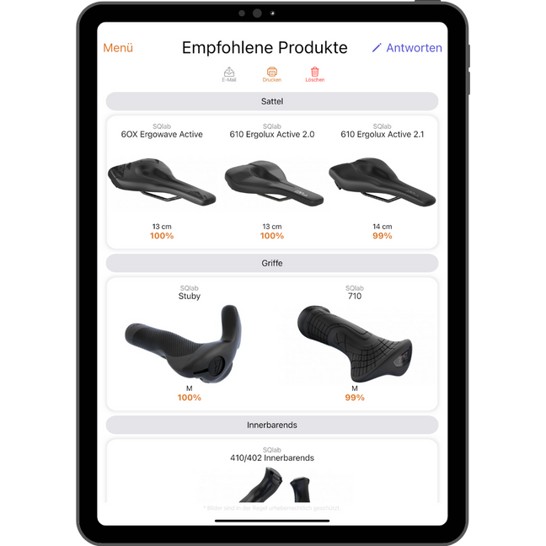

SQlab Profiler
Case Study
iPad app for 3D measurement and determination of suitable saddle, grip, etc.
→ Over 20.000 measurements worldwide
→ MVP after 2 months
A product for

Slide 6

Introduction to Flutter
Julian Hartl

Slide 7
Overview
Why Flutter?
Flutter Basics
Building a Chat-GPT Clone

Slide 8
Why Flutter?

Slide 9
What even is Flutter?

Slide 10
What even is Flutter?
“Flutter is an open source framework by Google for building beautiful, natively compiled, multi-platform applications from a single codebase.”

Slide 11
What even is Flutter?
“Flutter is an open source framework by Google for building beautiful, natively compiled, multi-platform applications from a single codebase.”
Open source UI software development toolkit
Supports many platforms
Single codebase

Slide 12

Your experience with mobile development
Did you enjoy it? Why/Why not?
Notes:
Was sind eure Erfahrung mit App Entwicklung?
Was erhofft ihr euch von diesem Workshop?

Slide 13
What does Flutter offer?

Slide 14
What does Flutter offer?
Cross-Platform development (Android, iOS, Web, Windows, macOS, Linux, Fuchsia)

Slide 15
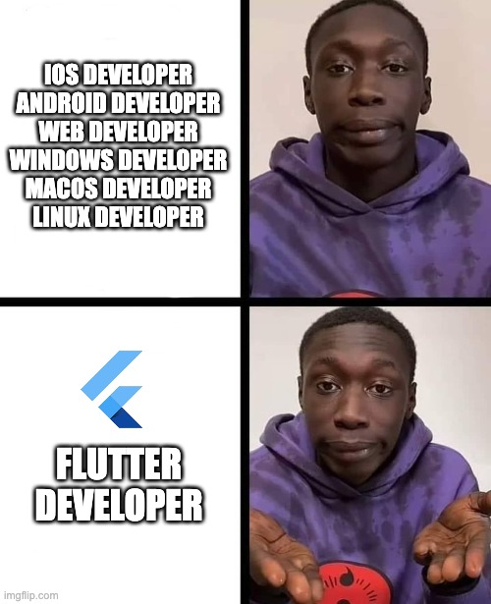
What does Flutter offer?
Cross-Platform development (Android, iOS, Web, Windows, macOS, Linux, Fuchsia)

Slide 16
What does Flutter offer?
Cross-Platform development (Android, iOS, Web, Windows, macOS, Linux, Fuchsia)
Performant due to Ahead-of-Time (AOT) Compilation of Dart

Slide 17
What does Flutter offer?
Cross-Platform development (Android, iOS, Web, Windows, macOS, Linux, Fuchsia)
Performant due to Ahead-of-Time (AOT) Compilation of Dart
Expressive and flexible UI (large set of prebuilt components)

Slide 18
What does Flutter offer?
Cross-Platform development (Android, iOS, Web, Windows, macOS, Linux, Fuchsia)
Performant due to Ahead-of-Time (AOT) Compilation of Dart
Expressive and flexible UI (large set of prebuilt components)
Hot reload (instant UI updates)

Slide 19
What does Flutter offer?
Cross-Platform development (Android, iOS, Web, Windows, macOS, Linux, Fuchsia)
Performant due to Ahead-of-Time (AOT) Compilation of Dart
Expressive and flexible UI (large set of prebuilt components)
Hot reload (instant UI updates)
Consistent behavior across all platforms

Slide 20

What does Flutter offer?
Cross-Platform development (Android, iOS, Web, Windows, macOS, Linux, Fuchsia)
Performant due to Ahead-of-Time (AOT) Compilation
Expressive and flexible UI (large set of prebuilt components)
Hot reload (instant UI updates)
Consistent behavior across all platforms

Slide 21
What does Flutter offer?
Cross-Platform development (Android, iOS, Web, Windows, macOS, Linux, Fuchsia)
Performant due to Ahead-of-Time (AOT) Compilation of Dart
Expressive and flexible UI (large set of prebuilt components)
Hot reload (instant UI updates)
Consistent behavior across all platforms
Strong community and ecosystem (wide adoption in the industry)

Slide 22
Applications in the wild

Slide 24

“Saved about 60-70% of their engineer’s time”

Slide 25

“Saved about 60-70% of their engineer’s time”
“Time saving & code-sharing”

Slide 26

“Saved about 60-70% of their engineer’s time”
“Time saving & code-sharing”
“No more troubleshooting cross-platform functionality”

Slide 27

“Saved about 60-70% of their engineer’s time”
“Time saving & code-sharing”
“No more troubleshooting cross-platform functionality”
”Build & design once”

Slide 28
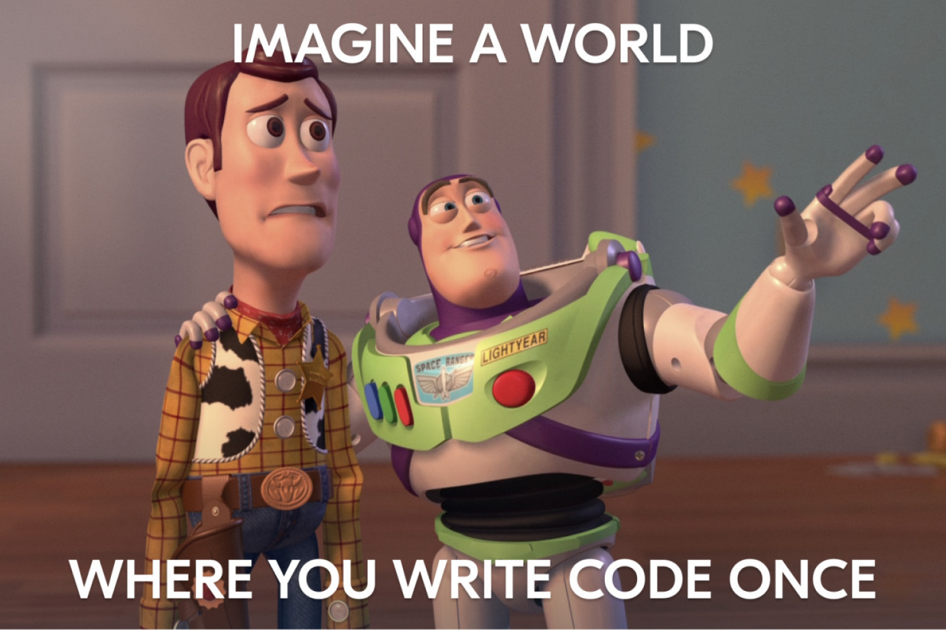
Summary
Build once for all platforms
Native performance
Rich ecosystem & wide adoption

Slide 29
Flutter Basics

Slide 30
Widgets

Slide 31
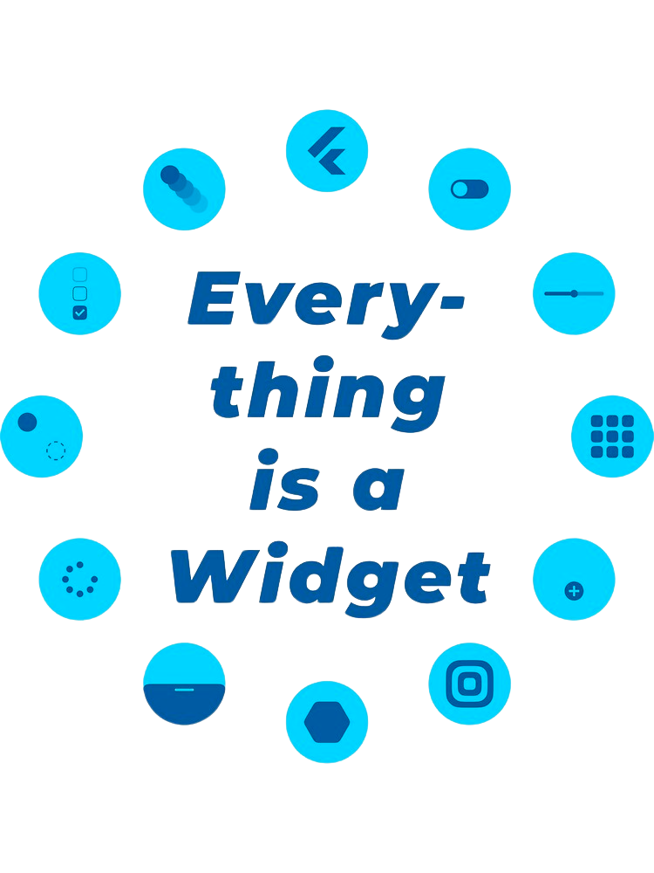
Notes:
jeder Screen besteht aus einer Vielzahl an Widgets

Slide 32
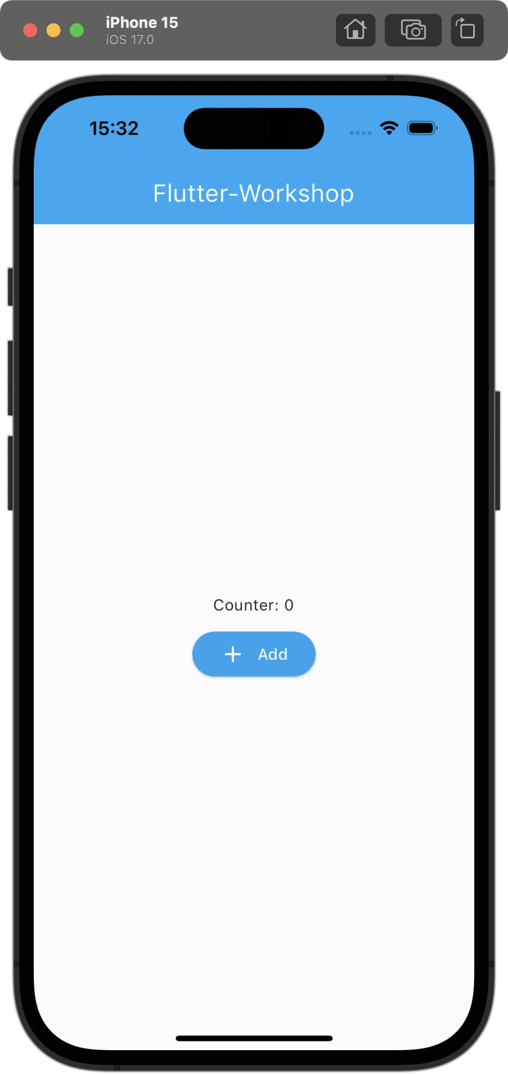

Slide 33
Root Widget

Slide 34
Root Widget

Slide 35
Root Widget
AppBar Widget

Slide 36
Root Widget
AppBar Widget
Text Widget

Slide 37
Root Widget
AppBar Widget
Center Widget
Text Widget

Slide 38
Root Widget
AppBar Widget
Center Widget
Text Widget
Column Widget

Slide 39
Root Widget
AppBar Widget
Center Widget
Text Widget
Column Widget
Text Widget

Slide 40
Root Widget
AppBar Widget
Center Widget
Text Widget
Column Widget
Text Widget
ElevatedButton Widget

Slide 41
Root Widget
AppBar Widget
Center Widget
Column Widget
Text Widget
ElevatedButton Widget
Text Widget
Row Widget

Slide 42
Root Widget
AppBar Widget
Center Widget
Column Widget
Text Widget
ElevatedButton Widget
Text Widget
Row Widget
Icon Widget

Slide 43
Root Widget
AppBar Widget
Center Widget
Column Widget
Text Widget
ElevatedButton Widget
Text Widget
Row Widget
Icon Widget
Text Widget

Slide 44
Root Widget
AppBar Widget
Center Widget
Column Widget
Text Widget
ElevatedButton Widget
Text Widget
Row Widget
Icon Widget
Text Widget

Slide 45
Root Widget
AppBar Widget
Center Widget
Column Widget
Text Widget
ElevatedButton Widget
Text Widget
Row Widget
Icon Widget
Text Widget
This is often called a widget tree

Slide 46
Widget Properties

Slide 47
Properties
Text Widget
ElevatedButton Widget
Column Widget
AppBar Widget

Slide 48
Properties
Text Widget
ElevatedButton Widget
Column Widget
AppBar Widget
style
textAlign
overflow
maxLines
…

Slide 49
Properties
Text Widget
ElevatedButton Widget
Column Widget
AppBar Widget
style
textAlign
overflow
maxLines
…
style
onPressed
…

Slide 50
Properties
Text Widget
ElevatedButton Widget
Column Widget
AppBar Widget
style
textAlign
overflow
maxLines
…
style
onPressed
…
mainAxisAlignment
crossAxisAlignment
…

Slide 51
Properties
Text Widget
ElevatedButton Widget
Column Widget
AppBar Widget
style
textAlign
overflow
maxLines
…
style
onPressed
…
mainAxisAlignment
crossAxisAlignment
…
title
backgroundColor
leading
…

Slide 52

Summary
“Everything is a widget”
A page is just a tree of widgets (including itself)
Widgets can be customized using their properties

Slide 53
Chat-GPT Clone
Notes:
iPad herumgeben!!!

Slide 54
Demo
Chat-GPT Clone
Notes:
iPad herumgeben!!!

Slide 55
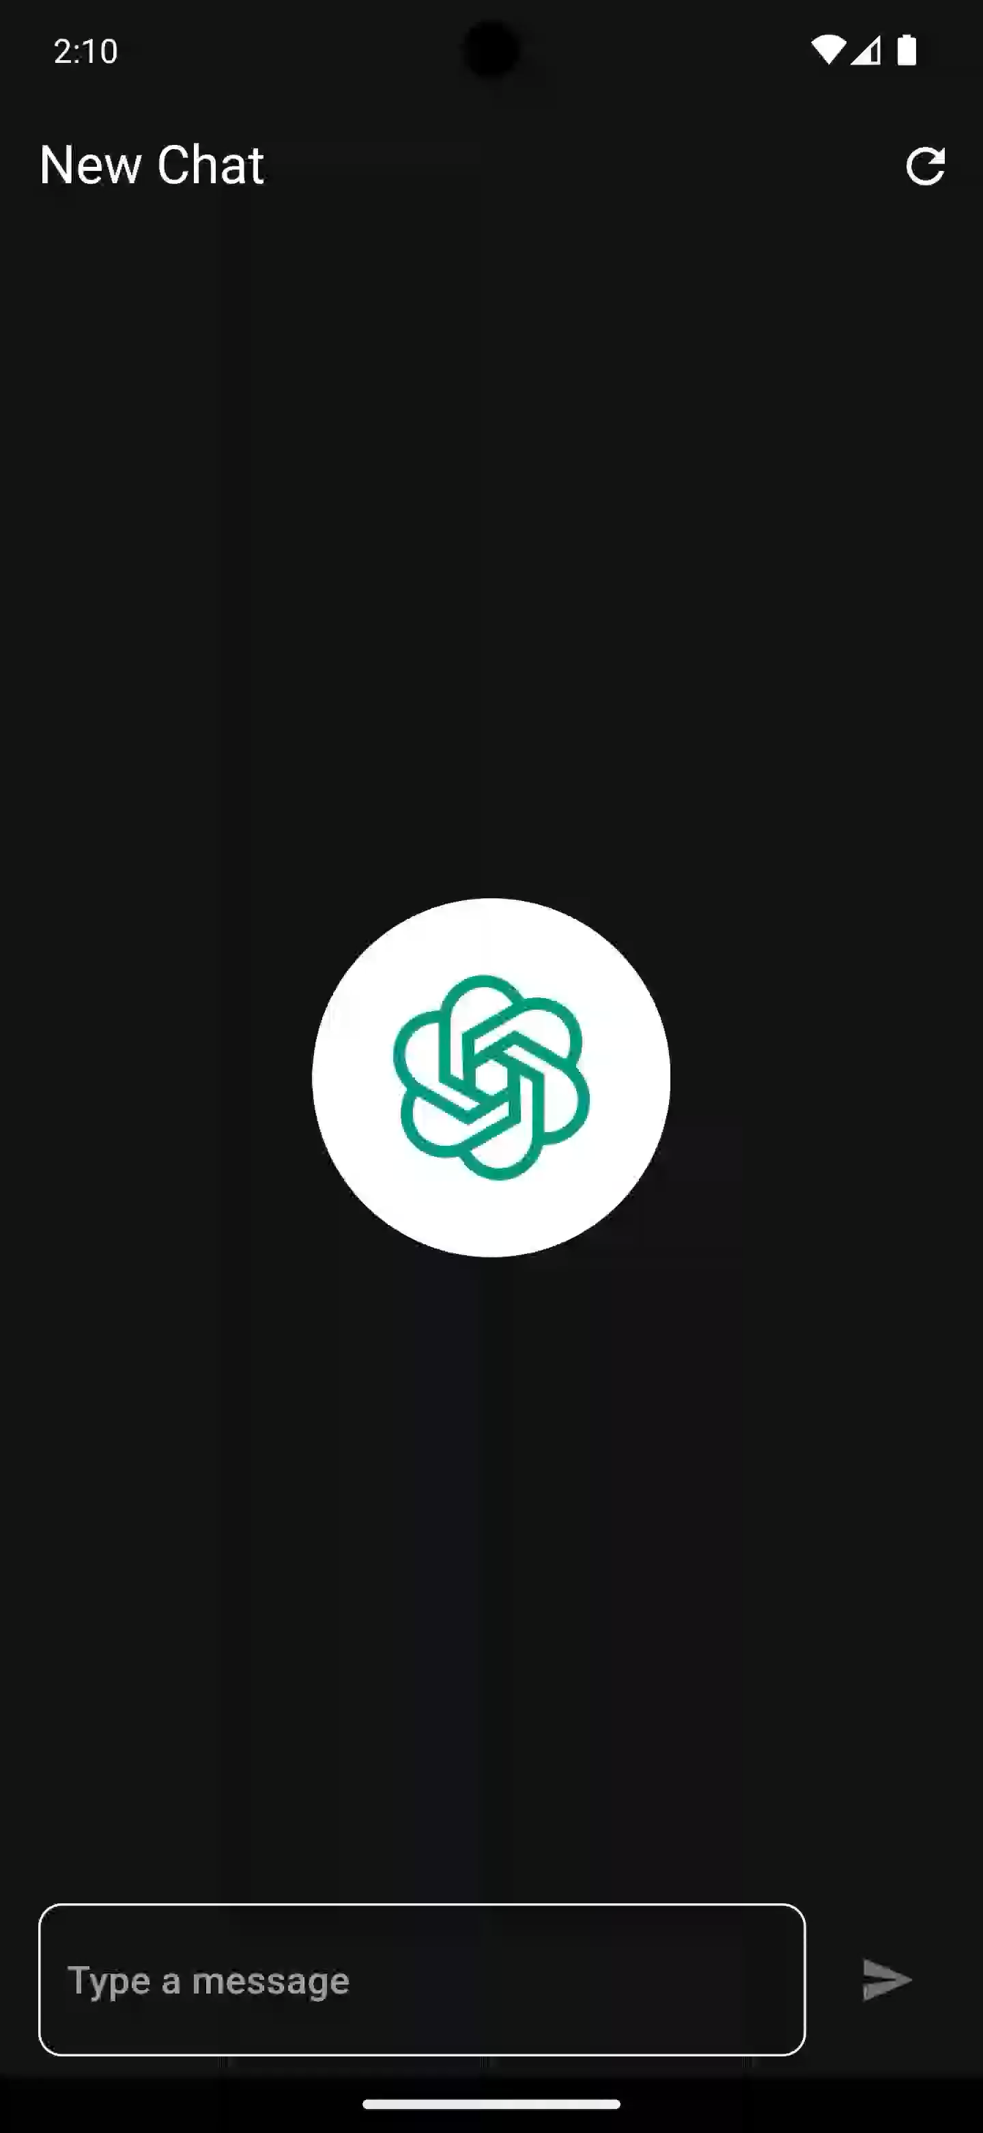


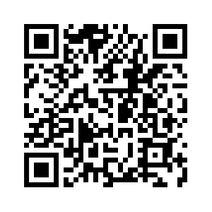


Slide 56
Architecture
Chat-GPT Clone

Slide 57


Authorize users
Authenticate
Chat CRUD

Slide 58
Design
Chat-GPT Clone

Slide 59
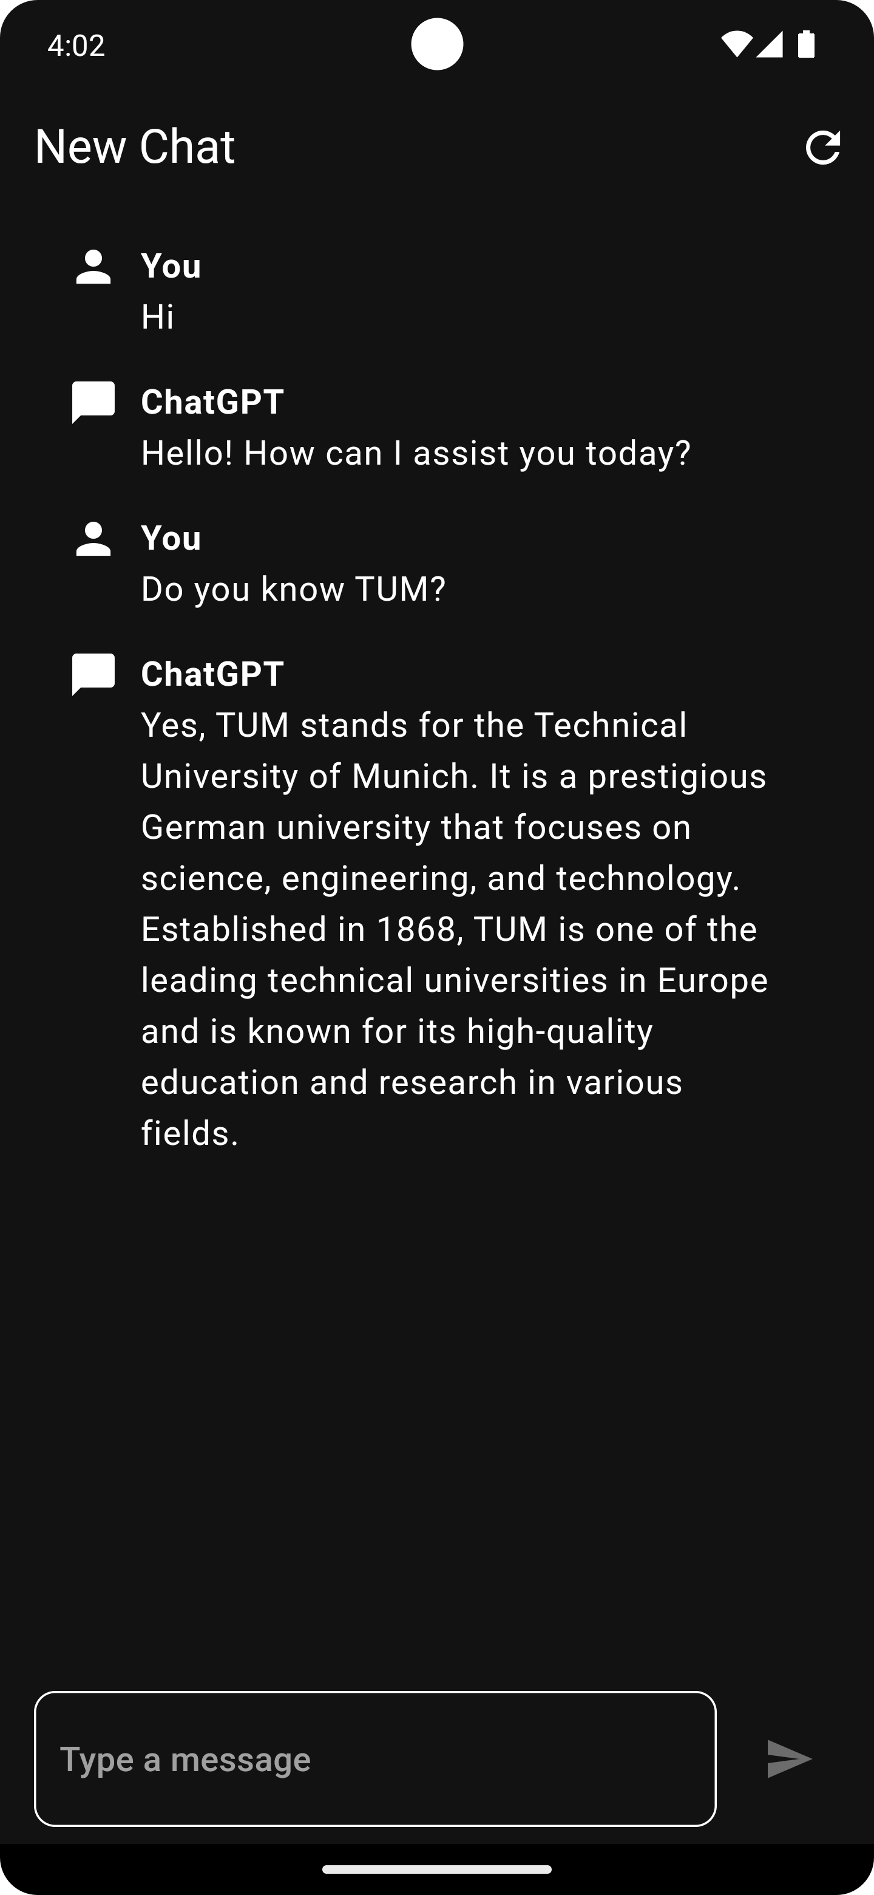

Slide 63
Flutter Inspector

Slide 66
class ChatInput extends StatefulWidget { const ChatInput({super.key}); @override State<ChatInput> createState() => _ChatInputState(); } class _ChatInputState extends State<ChatInput> { final TextEditingController _inputController = TextEditingController(); @override void dispose() { super.dispose(); _inputController.dispose(); } @override Widget build(BuildContext context) { return Row( children: [], ); } }

Slide 67
class ChatInput extends StatefulWidget { const ChatInput({super.key}); @override State<ChatInput> createState() => _ChatInputState(); } class _ChatInputState extends State<ChatInput> { final TextEditingController _inputController = TextEditingController(); @override void dispose() { super.dispose(); _inputController.dispose(); } @override Widget build(BuildContext context) { return Row( children: [], ); } }
You can create widget boilerplate code using live templates in your editor

Slide 68
class ChatInput extends StatefulWidget { const ChatInput({super.key}); @override State<ChatInput> createState() => _ChatInputState(); } class _ChatInputState extends State<ChatInput> { final TextEditingController _inputController = TextEditingController(); @override void dispose() { super.dispose(); _inputController.dispose(); } @override Widget build(BuildContext context) { return Row( children: [], ); } }
👆 Widget has mutable state

Slide 69
class ChatInput extends StatefulWidget { const ChatInput({super.key}); @override State<ChatInput> createState() => _ChatInputState(); } class _ChatInputState extends State<ChatInput> { final TextEditingController _inputController = TextEditingController(); @override void dispose() { super.dispose(); _inputController.dispose(); } @override Widget build(BuildContext context) { return Row( children: [], ); } }
👆 Widget has mutable state
👇 State of the ChatInput Widget

Slide 70
class ChatInput extends StatefulWidget { const ChatInput({super.key}); @override State<ChatInput> createState() => _ChatInputState(); } class _ChatInputState extends State<ChatInput> { final TextEditingController _inputController = TextEditingController(); @override void dispose() { super.dispose(); _inputController.dispose(); } @override Widget build(BuildContext context) { return Row( children: [], ); } }

Slide 71
class ChatInput extends StatefulWidget { const ChatInput({super.key}); @override State<ChatInput> createState() => _ChatInputState(); } class _ChatInputState extends State<ChatInput> { final TextEditingController _inputController = TextEditingController(); @override void dispose() { super.dispose(); _inputController.dispose(); } @override Widget build(BuildContext context) { return Row( children: [], ); } }
👆 Controller for the text field

Slide 72
class ChatInput extends StatefulWidget { const ChatInput({super.key}); @override State<ChatInput> createState() => _ChatInputState(); } class _ChatInputState extends State<ChatInput> { final TextEditingController _inputController = TextEditingController(); @override void dispose() { super.dispose(); _inputController.dispose(); } @override Widget build(BuildContext context) { return Row( children: [], ); } }
👆 Controller for the text field
👈 Called on end of widget lifecycle

Slide 73
class ChatInput extends StatefulWidget { const ChatInput({super.key}); @override State<ChatInput> createState() => _ChatInputState(); } class _ChatInputState extends State<ChatInput> { final TextEditingController _inputController = TextEditingController(); @override void dispose() { super.dispose(); _inputController.dispose(); } @override Widget build(BuildContext context) { return Row( children: [], ); } }
👆 Controller for the text field
👈 Called on end of widget lifecycle
👈 Defines the content of the widget

Slide 74
@override Widget build(BuildContext context) { return Row( children: [], ); }

Slide 75
@override Widget build(BuildContext context) { return Row( children: [ Expanded( child: TextFormField( controller: _inputController, decoration: const InputDecoration( hintText: 'Type a message', ), ), ), const SizedBox( width: 10, ), IconButton( onPressed: onSendPressed, icon: const Icon(Icons.send), ) ], ); }

Slide 76
@override Widget build(BuildContext context) { return Row( children: [ Expanded( child: TextFormField( controller: _inputController, decoration: const InputDecoration( hintText: 'Type a message', ), ), ), const SizedBox( width: 10, ), IconButton( onPressed: onSendPressed, icon: const Icon(Icons.send), ) ], ); }
👈 Expand TextFormField to its maximum size

Slide 77
@override Widget build(BuildContext context) { return Row( children: [ Expanded( child: TextFormField( controller: _inputController, decoration: const InputDecoration( hintText: 'Type a message', ), ), ), const SizedBox( width: 10, ), IconButton( onPressed: onSendPressed, icon: const Icon(Icons.send), ) ], ); }
👈 Expand TextFormField to its maximum size
👈 Horizontal space

Slide 78
@override Widget build(BuildContext context) { return Row( children: [ Expanded( child: TextFormField( controller: _inputController, decoration: const InputDecoration( hintText: 'Type a message', ), ), ), const SizedBox( width: 10, ), IconButton( onPressed: onSendPressed, icon: const Icon(Icons.send), ) ], ); }
👈 Expand TextFormField to its maximum size
👈 Horizontal space
👈 Called when button is pressed

Slide 79
@override Widget build(BuildContext context) { return Row( children: [ Expanded( child: TextFormField( controller: _inputController, decoration: const InputDecoration( hintText: 'Type a message', ), ), ), const SizedBox( width: 10, ), if (_isSending) const CircularProgressIndicator() else IconButton( onPressed: onSendPressed, icon: const Icon(Icons.send), ) ], ); }
👈 Show progress indicator while sending a message

Slide 80
bool _isSending = false; void onSendPressed() async { try { setState(() { _isSending = true; }); ... } finally { setState(() { _isSending = false; }); } }

Slide 81
bool _isSending = false; void onSendPressed() async { try { setState(() { _isSending = true; }); ... } finally { setState(() { _isSending = false; }); } }
👈 Rebuild children with updated state

Slide 82
bool _isSending = false; void onSendPressed() async { try { setState(() { _isSending = true; }); ... } finally { setState(() { _isSending = false; }); } }
👈 Rebuild children with updated state
👈 Send message logic

Slide 83
bool _isSending = false; void onSendPressed() async { try { setState(() { _isSending = true; }); ... } finally { setState(() { _isSending = false; }); } }
👈 Rebuild children with updated state
👈 Send message logic
👆 Set sending flag to false

Slide 84
class ChatInput extends StatefulWidget { const ChatInput({super.key}); @override State<ChatInput> createState() => _ChatInputState(); } class _ChatInputState extends State<ChatInput> { final TextEditingController _inputController = TextEditingController(); @override void dispose() { super.dispose(); _inputController.dispose(); } bool _isSending = false; void onSendPressed() async { try { setState(() { _isSending = true; }); final chatProvider = context.read<ChatProvider>(); await chatProvider.sendMessage( _inputController.text.trim(), ); _inputController.clear(); await chatProvider.requestResponse(); } finally { setState(() { _isSending = false; }); } }
@override Widget build(BuildContext context) { return Row( children: [ Expanded( child: TextFormField( controller: _inputController, decoration: const InputDecoration( hintText: 'Type a message', ), ), ), const SizedBox( width: 10, ), if (_isSending) const CircularProgressIndicator() else ListenableBuilder( listenable: _inputController, builder: (context, _) { return IconButton( onPressed: _inputController.text.isEmpty ? null : onSendPressed, icon: const Icon(Icons.send), ); }, ), ], ); } }

Slide 87
class ChatDisplay extends StatelessWidget {
const ChatDisplay({super.key, required this.chat}); final Chat chat; @override Widget build(BuildContext context) { return ListView.builder( itemBuilder: (context, index) { final message = chat.messages[index]; return ChatMessageTile(message: message); }, itemCount: chat.messages.length, ); } }

Slide 88
class ChatDisplay extends StatelessWidget {
const ChatDisplay({super.key, required this.chat}); final Chat chat; @override Widget build(BuildContext context) { return ListView.builder( itemBuilder: (context, index) { final message = chat.messages[index]; return ChatMessageTile(message: message); }, itemCount: chat.messages.length, ); } }
👆 Widget has no mutable state

Slide 89
class ChatDisplay extends StatelessWidget {
const ChatDisplay({super.key, required this.chat}); final Chat chat; @override Widget build(BuildContext context) { return ListView.builder( itemBuilder: (context, index) { final message = chat.messages[index]; return ChatMessageTile(message: message); }, itemCount: chat.messages.length, ); } }
👆 Widget has no mutable state
👈 Build Widget for each message

Slide 90
class ChatMessageTile extends StatelessWidget { const ChatMessageTile({ super.key, required this.message, }); final ChatMessage message; @override Widget build(BuildContext context) { return ListTile( ); } }

Slide 91
@override Widget build(BuildContext context) { return ListTile( title: Row( crossAxisAlignment: CrossAxisAlignment.start, children: [ if (message.sender == Sender.user) const Icon(Icons.person) else const Icon(Icons.chat_bubble), const SizedBox( width: 10, ), Expanded( child: Column( crossAxisAlignment: CrossAxisAlignment.start, children: [ Text( message.sender.displayText, style: const TextStyle( fontWeight: FontWeight.bold, ), ), Text(message.text), ], ), ), ], ), ); }

Slide 92
@override Widget build(BuildContext context) { return ListTile( title: Row( crossAxisAlignment: CrossAxisAlignment.start, children: [ if (message.sender == Sender.user) const Icon(Icons.person) else const Icon(Icons.chat_bubble), const SizedBox( width: 10, ), Expanded( child: Column( crossAxisAlignment: CrossAxisAlignment.start, children: [ Text( message.sender.displayText, style: const TextStyle( fontWeight: FontWeight.bold, ), ), Text(message.text), ], ), ), ], ), ); }
👈 Choose icon depending on sender

Slide 93
@override Widget build(BuildContext context) { return ListTile( title: Row( crossAxisAlignment: CrossAxisAlignment.start, children: [ if (message.sender == Sender.user) const Icon(Icons.person) else const Icon(Icons.chat_bubble), const SizedBox( width: 10, ), Expanded( child: Column( crossAxisAlignment: CrossAxisAlignment.start, children: [ Text( message.sender.displayText, style: const TextStyle( fontWeight: FontWeight.bold, ), ), Text(message.text), ], ), ), ], ), ); }
👈 Choose icon depending on sender
👈 Horizontal space

Slide 94
@override Widget build(BuildContext context) { return ListTile( title: Row( crossAxisAlignment: CrossAxisAlignment.start, children: [ if (message.sender == Sender.user) const Icon(Icons.person) else const Icon(Icons.chat_bubble), const SizedBox( width: 10, ), Expanded( child: Column( crossAxisAlignment: CrossAxisAlignment.start, children: [ Text( message.sender.displayText, style: const TextStyle( fontWeight: FontWeight.bold, ), ), Text(message.text), ], ), ), ], ), ); }
👈 Choose icon depending on sender
👈 Horizontal space
Align Texts to the left 👆

Slide 95
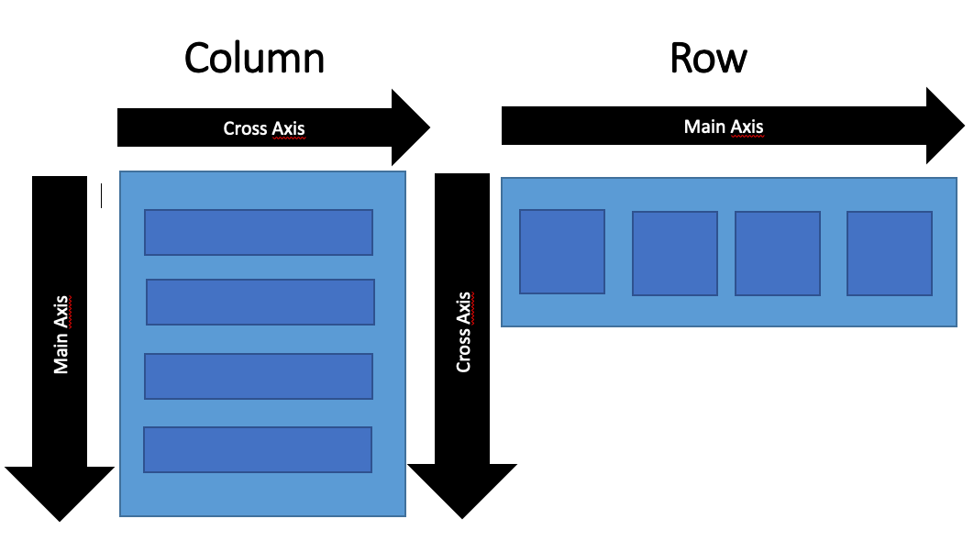
@override Widget build(BuildContext context) { return ListTile( title: Row( crossAxisAlignment: CrossAxisAlignment.start, children: [ if (message.sender == Sender.user) const Icon(Icons.person) else const Icon(Icons.chat_bubble), const SizedBox( width: 10, ), Expanded( child: Column( crossAxisAlignment: CrossAxisAlignment.start, children: [ Text( message.sender.displayText, style: const TextStyle( fontWeight: FontWeight.bold, ), ), Text(message.text), ], ), ), ], ), ); }
👈 Choose icon depending on sender
👈 Horizontal space
Align Texts to the left 👆

Slide 96
@override Widget build(BuildContext context) { return ListTile( title: Row( crossAxisAlignment: CrossAxisAlignment.start, children: [ if (message.sender == Sender.user) const Icon(Icons.person) else const Icon(Icons.chat_bubble), const SizedBox( width: 10, ), Expanded( child: Column( crossAxisAlignment: CrossAxisAlignment.start, children: [ Text( message.sender.displayText, style: const TextStyle( fontWeight: FontWeight.bold, ), ), Text(message.text), ], ), ), ], ), ); }
👈 Choose icon depending on sender
👈 Horizontal space
Align Texts to the left 👆

Slide 97
@override Widget build(BuildContext context) { return ListTile( title: Row( crossAxisAlignment: CrossAxisAlignment.start, children: [ if (message.sender == Sender.user) const Icon(Icons.person) else const Icon(Icons.chat_bubble), const SizedBox( width: 10, ), Expanded( child: Column( crossAxisAlignment: CrossAxisAlignment.start, children: [ Text( message.sender.displayText, style: const TextStyle( fontWeight: FontWeight.bold, ), ), Text(message.text), ], ), ), ], ), ); }
👈 Choose icon depending on sender
👈 Horizontal space
Align Texts to the left 👆
Make sender name bold 👆

Slide 98
class ChatDisplay extends StatelessWidget { const ChatDisplay({super.key, required this.chat}); final Chat chat; @override Widget build(BuildContext context) { if (chat.messages.isEmpty) { return Center( child: ConstrainedBox( constraints: const BoxConstraints( maxWidth: 300, ), child: const FractionallySizedBox( widthFactor: 0.5, child: Image( image: AssetImage('assets/images/chatgpt.png'), ), ), ), ); } return ListView.builder( itemBuilder: (context, index) { final message = chat.messages[index]; return ChatMessageTile(message: message); }, itemCount: chat.messages.length, ); } }
class ChatMessageTile extends StatelessWidget { const ChatMessageTile({ super.key, required this.message, }); final ChatMessage message; @override Widget build(BuildContext context) { return ListTile( title: Row( crossAxisAlignment: CrossAxisAlignment.start, children: [ if (message.sender == Sender.user) const Icon(Icons.person) else const Icon(Icons.chat_bubble), const SizedBox( width: 10, ), Expanded( child: Column( crossAxisAlignment: CrossAxisAlignment.start, children: [ Text( message.sender.displayText, style: const TextStyle( fontWeight: FontWeight.bold, ), ), Text(message.text), ], ), ), ], ), ); } }

Slide 101
class Home extends StatefulWidget { const Home({super.key}); @override State<Home> createState() => _HomeState(); } class _HomeState extends State<Home> { @override Widget build(BuildContext context) { } AppBar buildAppBar(Chat? chat, BuildContext context) { ... } }

Slide 102
@override Widget build(BuildContext context) { final chatProvider = context.watch<ChatProvider>(); final chat = chatProvider.currentChat; return Scaffold( appBar: buildAppBar(chat, context), body: SafeArea( child: Padding( padding: const EdgeInsets.symmetric(horizontal: 16, vertical: 8), child: Column( children: [ Expanded( child: chat == null ? const Center( child: CircularProgressIndicator(), ) : ChatDisplay(chat: chat), ), const ChatInput(), ], ), ), ), ); }

Slide 103
@override Widget build(BuildContext context) { final chatProvider = context.watch<ChatProvider>(); final chat = chatProvider.currentChat; return Scaffold( appBar: buildAppBar(chat, context), body: SafeArea( child: Padding( padding: const EdgeInsets.symmetric(horizontal: 16, vertical: 8), child: Column( children: [ Expanded( child: chat == null ? const Center( child: CircularProgressIndicator(), ) : ChatDisplay(chat: chat), ), const ChatInput(), ], ), ), ), ); }
👈 Places widgets in a predefined layout

Slide 104
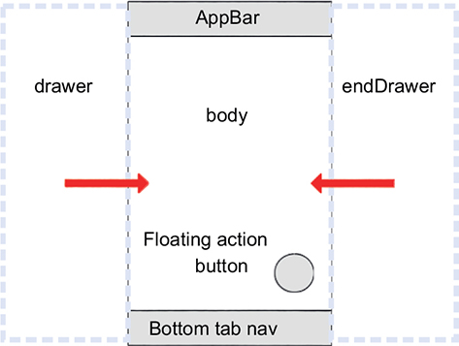
@override Widget build(BuildContext context) { final chatProvider = context.watch<ChatProvider>(); final chat = chatProvider.currentChat; return Scaffold( appBar: buildAppBar(chat, context), body: SafeArea( child: Padding( padding: const EdgeInsets.symmetric(horizontal: 16, vertical: 8), child: Column( children: [ Expanded( child: chat == null ? const Center( child: CircularProgressIndicator(), ) : ChatDisplay(chat: chat), ), const ChatInput(), ], ), ), ), ); }
👈 Places widgets in a predefined layout

Slide 105
@override Widget build(BuildContext context) { final chatProvider = context.watch<ChatProvider>(); final chat = chatProvider.currentChat; return Scaffold( appBar: buildAppBar(chat, context), body: SafeArea( child: Padding( padding: const EdgeInsets.symmetric(horizontal: 16, vertical: 8), child: Column( children: [ Expanded( child: chat == null ? const Center( child: CircularProgressIndicator(), ) : ChatDisplay(chat: chat), ), const ChatInput(), ], ), ), ), ); }
👈 Places widgets in a predefined layout
👈 Applies padding to child

Slide 106
@override Widget build(BuildContext context) { final chatProvider = context.watch<ChatProvider>(); final chat = chatProvider.currentChat; return Scaffold( appBar: buildAppBar(chat, context), body: SafeArea( child: Padding( padding: const EdgeInsets.symmetric(horizontal: 16, vertical: 8), child: Column( children: [ Expanded( child: chat == null ? const Center( child: CircularProgressIndicator(), ) : ChatDisplay(chat: chat), ), const ChatInput(), ], ), ), ), ); }
👈 Places widgets in a predefined layout
👈 Applies padding to child
👈 Show loading indicator

Slide 107
class Home extends StatefulWidget { const Home({super.key}); @override State<Home> createState() => _HomeState(); } class _HomeState extends State<Home> { @override void initState() { super.initState(); WidgetsBinding.instance.addPostFrameCallback((_) { final authProvider = context.read<AuthProvider>(); VoidCallback? listener; listener = () { if (authProvider.currentUser == null) { return; } final chatProvider = context.read<ChatProvider>(); chatProvider.loadCurrentOrCreateChat(); authProvider.removeListener(listener!); }; authProvider.addListener(listener); }); } AppBar buildAppBar(Chat? chat, BuildContext context) { return AppBar( title: Text(chat?.title ?? 'ChatGPT'), actions: [ IconButton( onPressed: () async { await context.read<ChatProvider>().startNewChat(); }, icon: const Icon(Icons.refresh), ), ], ); } }
@override Widget build(BuildContext context) { final authProvider = context.watch<AuthProvider>(); if (authProvider.currentUser == null) { return const Scaffold( body: Center( child: CircularProgressIndicator(), ), ); } final chatProvider = context.watch<ChatProvider>(); final chat = chatProvider.currentChat; return Scaffold( appBar: buildAppBar(chat, context), body: SafeArea( child: Padding( padding: const EdgeInsets.symmetric(horizontal: 16, vertical: 8), child: Column( children: [ Expanded( child: chat == null ? const Center( child: CircularProgressIndicator(), ) : ChatDisplay(chat: chat), ), const ChatInput(), ], ), ), ), ); }

Slide 108


Slide 109


Slide 110
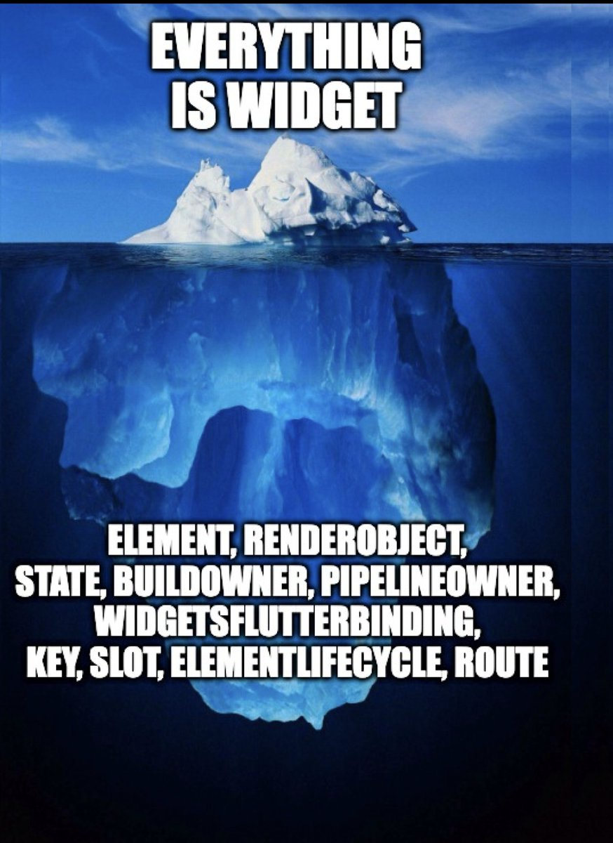
That’s it!
Thank you for listening!
Do you have any questions?

